Slide 1




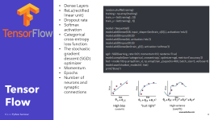


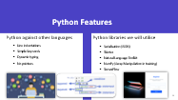
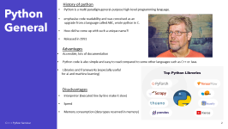


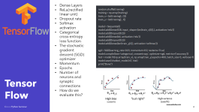
C+++ Seminar
Owain 30026487
Zsolt 30047627
Ben 30030434
Kinmon 30023283

Slide 2
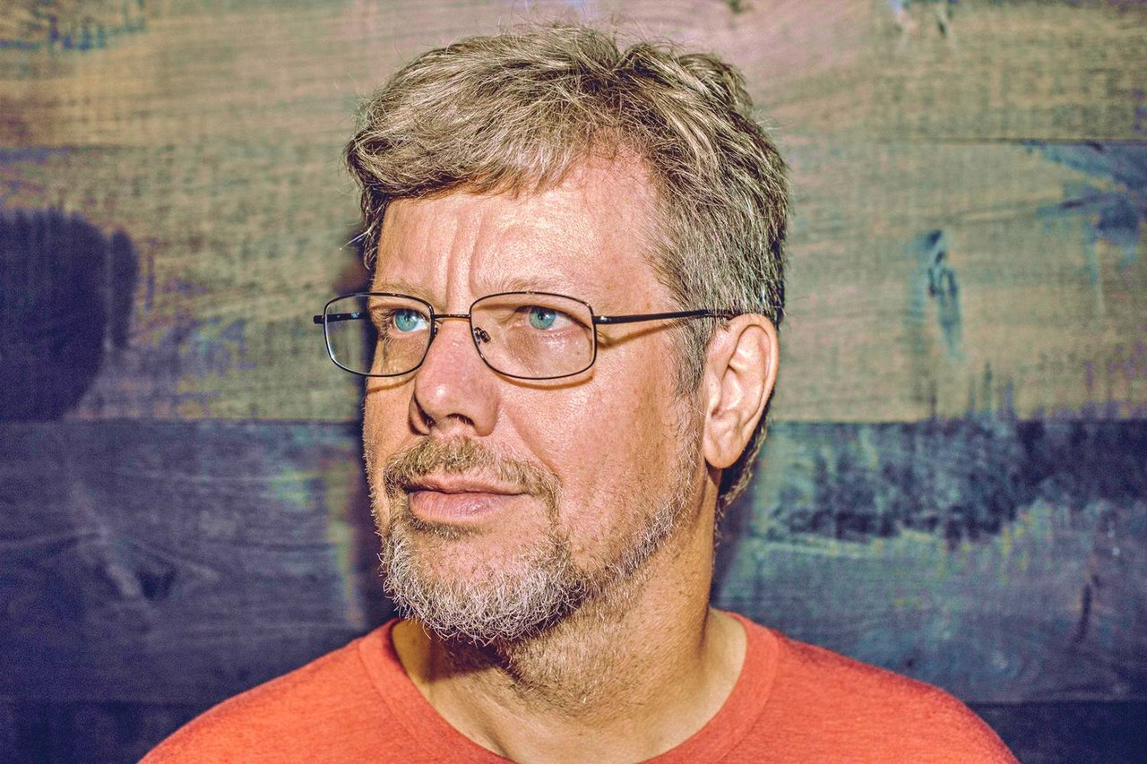
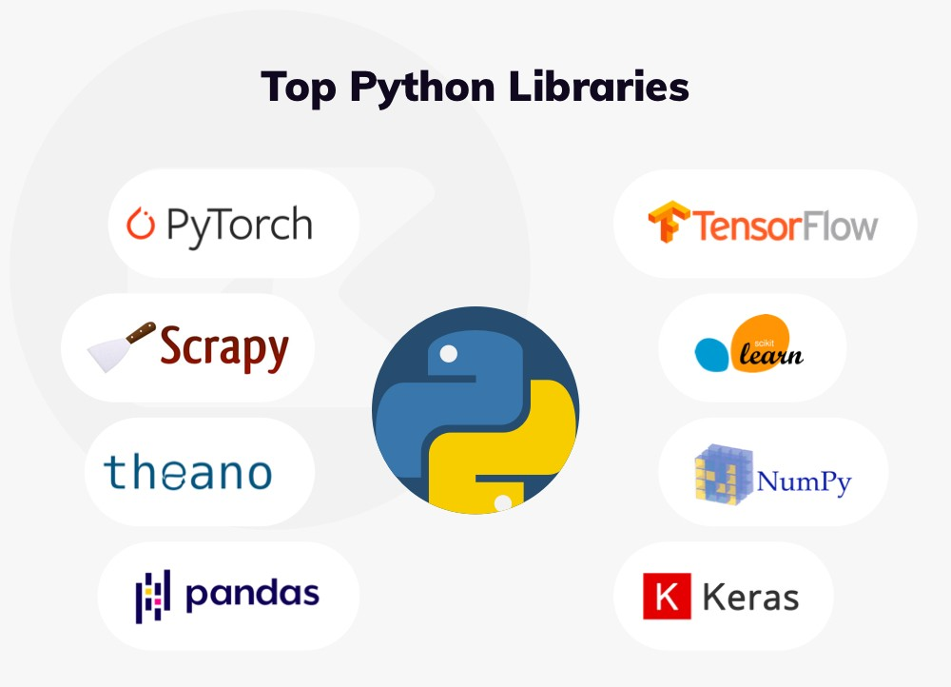
Python General
History of python
Python is a multi paradigm general-purpose high-level programming language.
emphasise code readability and was conceived as an
upgrade from a language called ABC, wrote python in C.
How did he come up with such a unique name?!
Released in 1991
Advantages
Accessible, lots of documentation
Python code is also simple and easy to read compared to some other languages such as C++ or Java.
Libraries and frameworks (especially useful
for ai and machine learning)
Disadvantages
Interpreter (Executed line by line make it slow)
Speed
Memory consumption (data types reserved in memory)

Slide 3
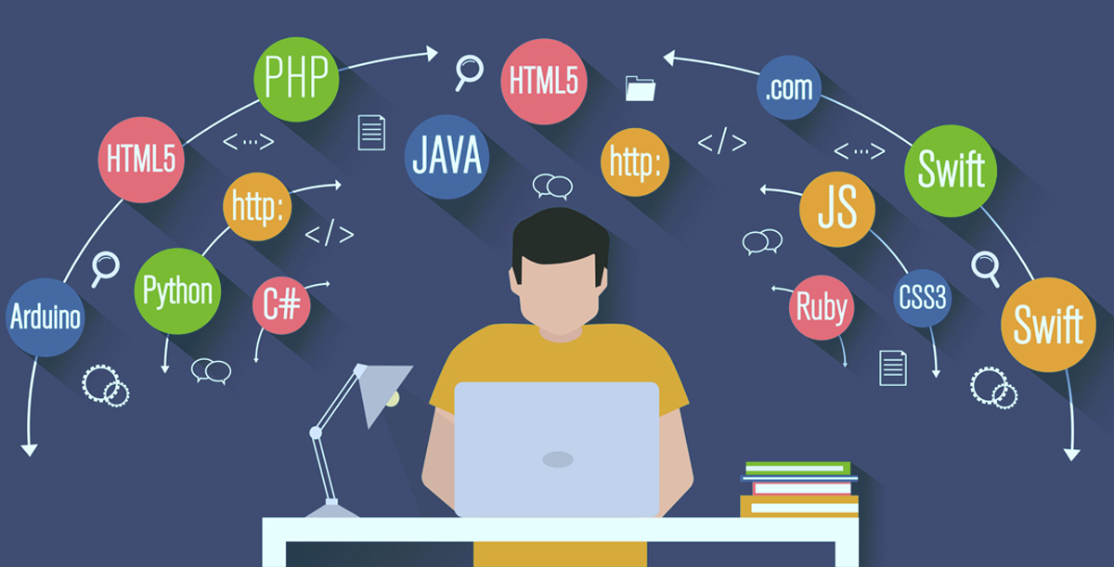
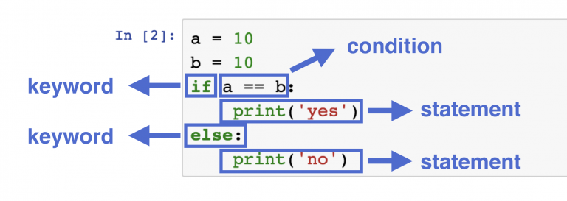
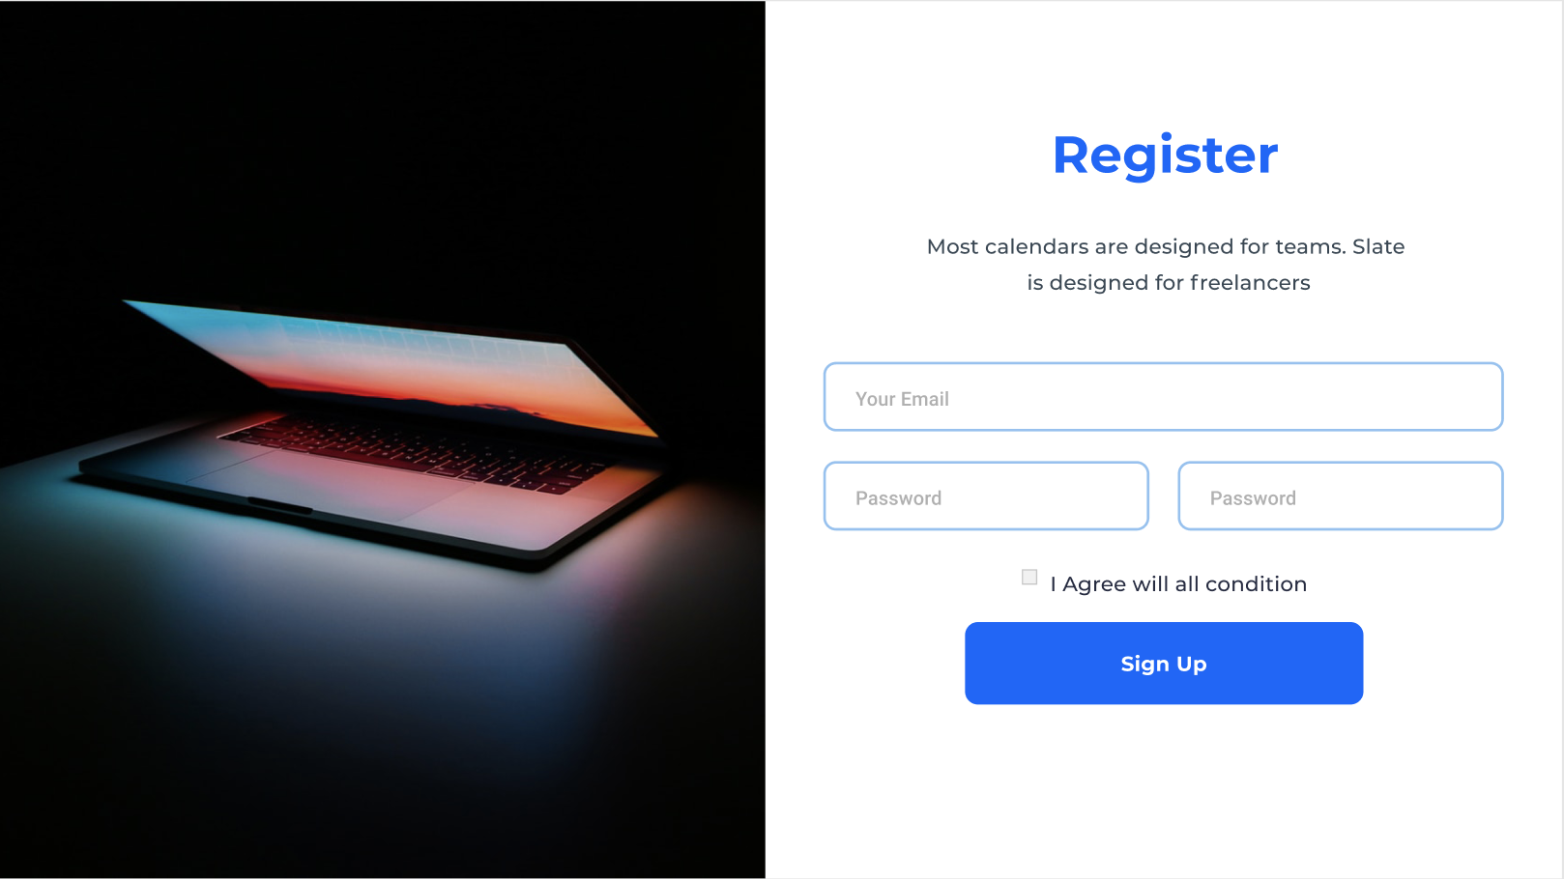
Python Features
Python against other languages
Python libraries we will utilise
  Line indentations
  Simple keywords
  Dynamic typing
  No pointers
  Serialisation (JSON)
  Tkinter
  Natural Language Toolkit
  NumPy (Array Manipulation in training)
  TensorFlow

Slide 4
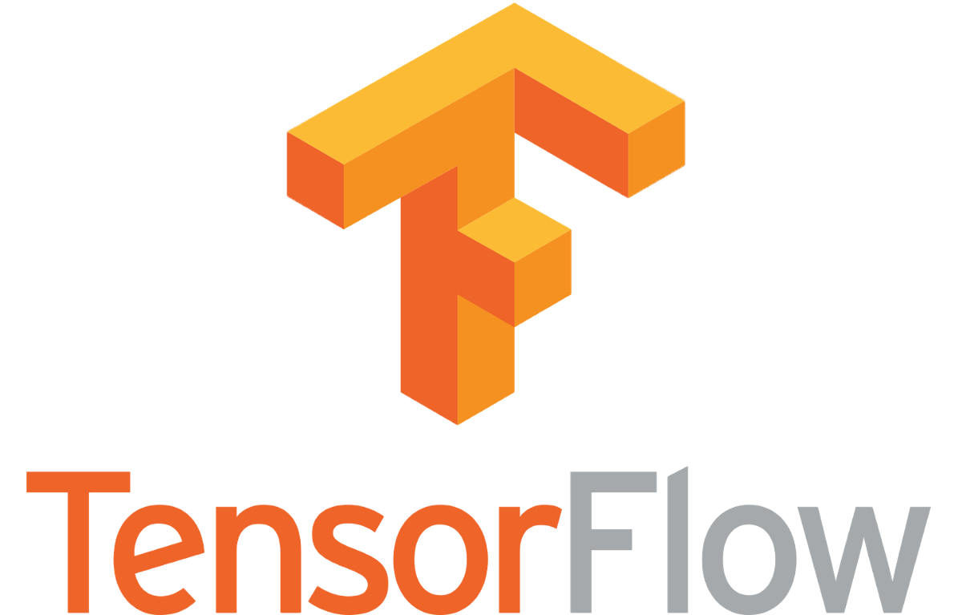
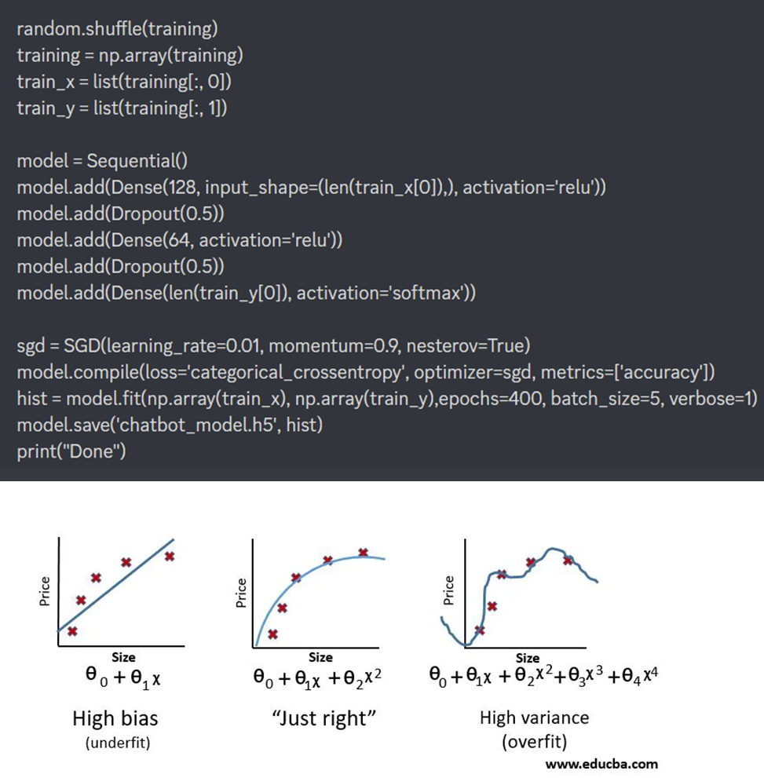
TensorFlow
Dense Layers
ReLu(rectified linear unit)
Dropout rate
Softmax activation
Categorical cross-entropy loss function
The stochastic gradient descent (SGD) optimizer
Momentum
Epochs
Number of neurons and synaptic connections

Slide 5


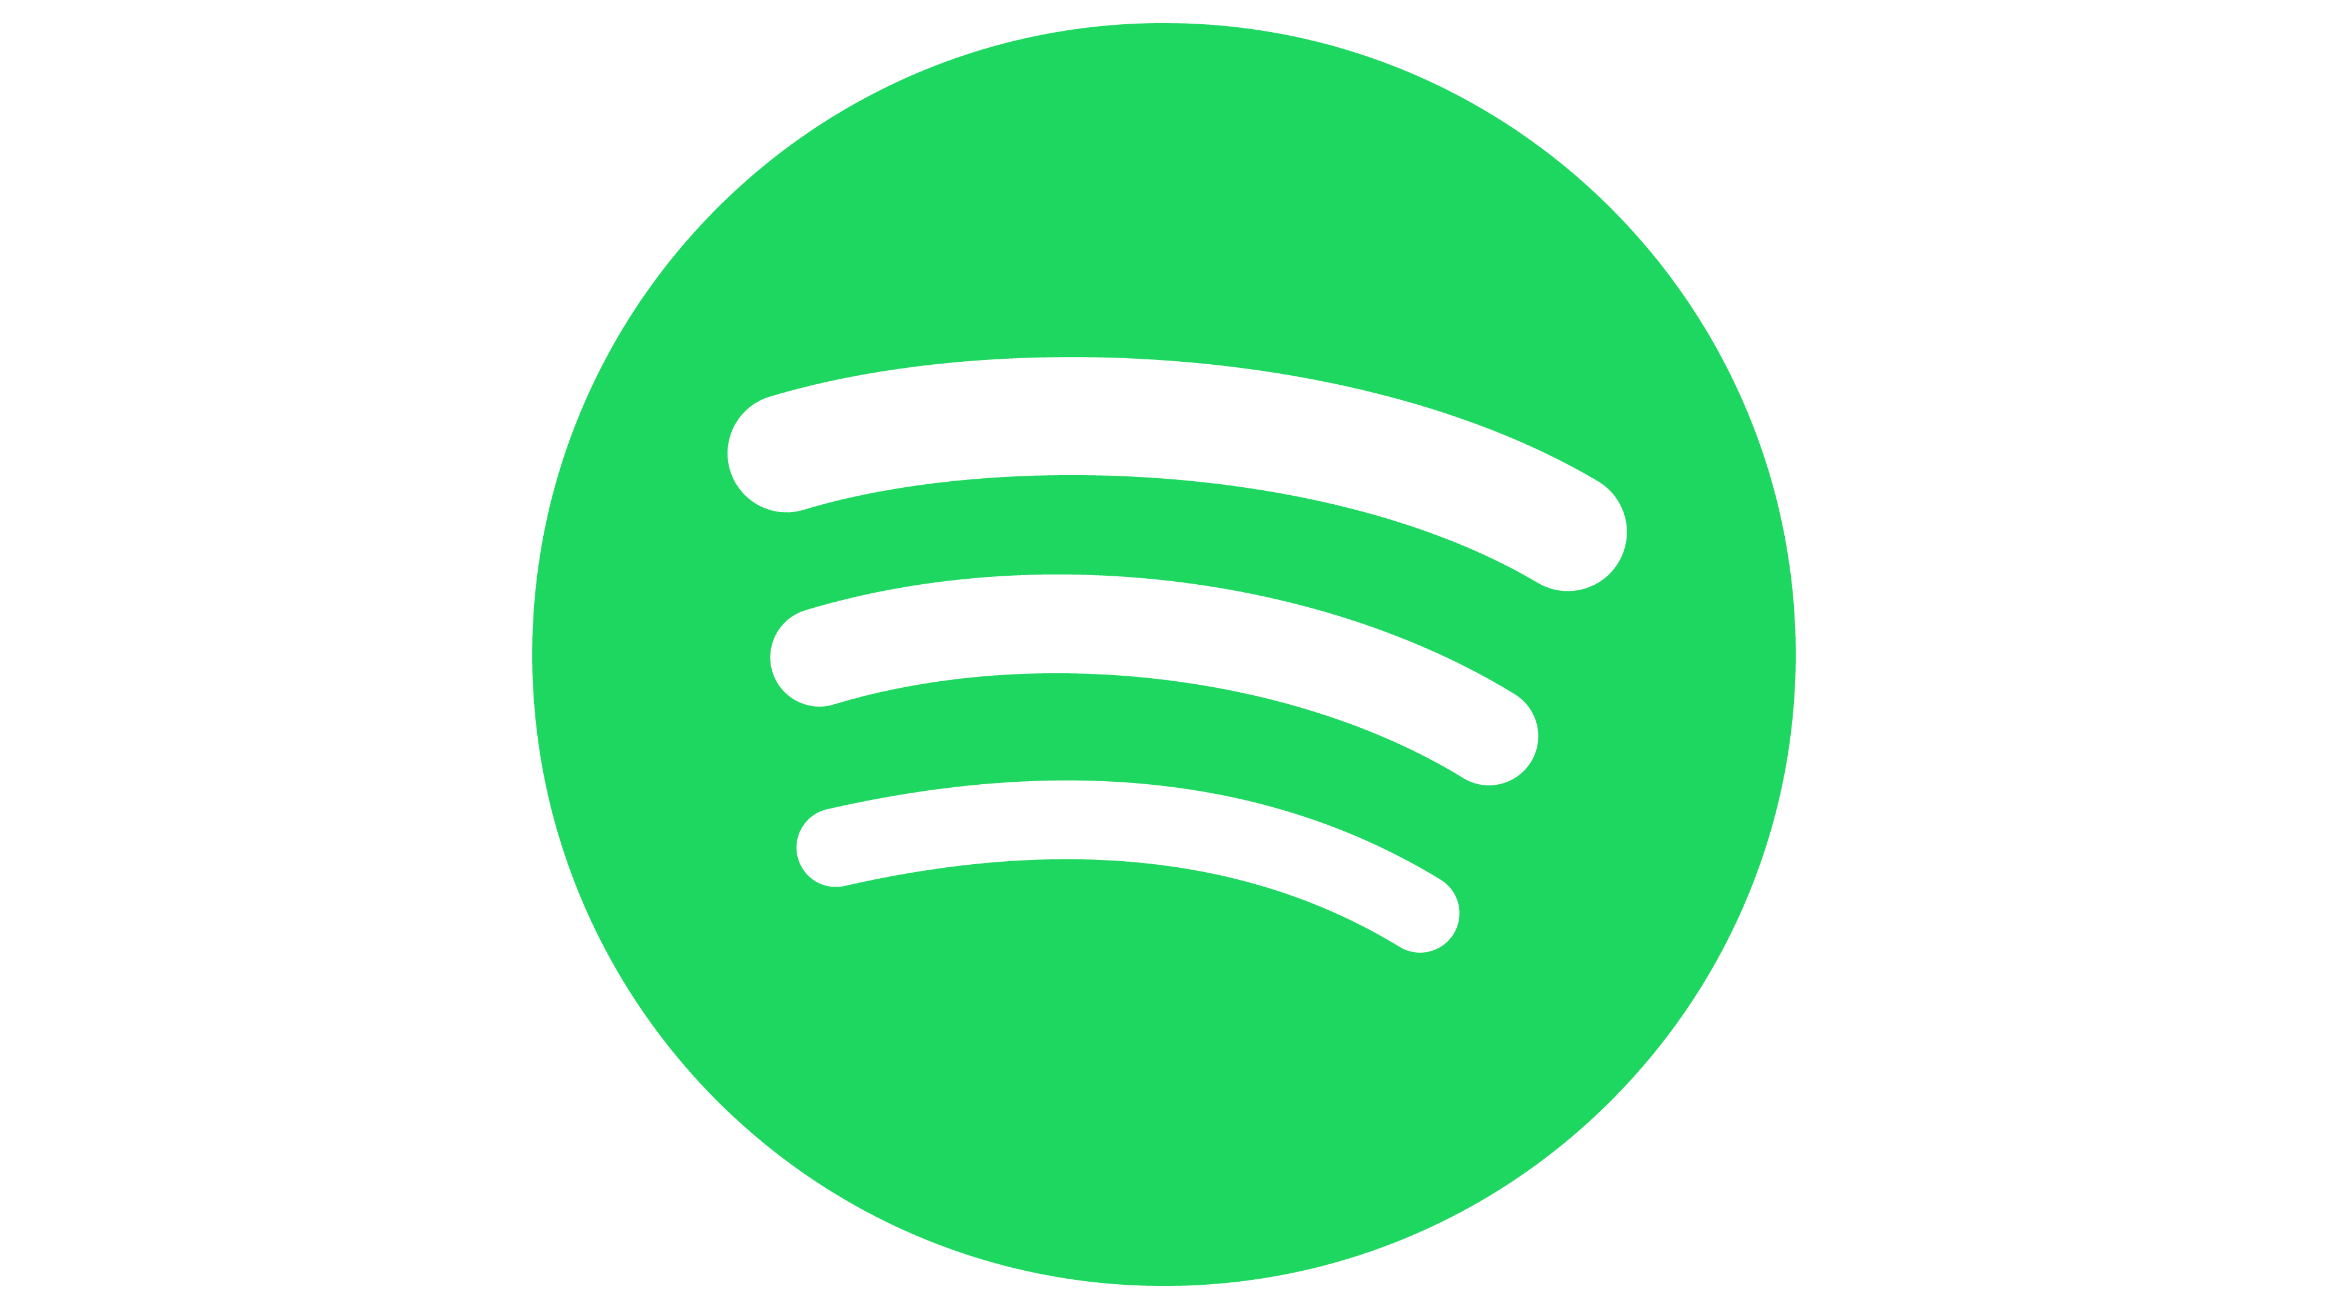
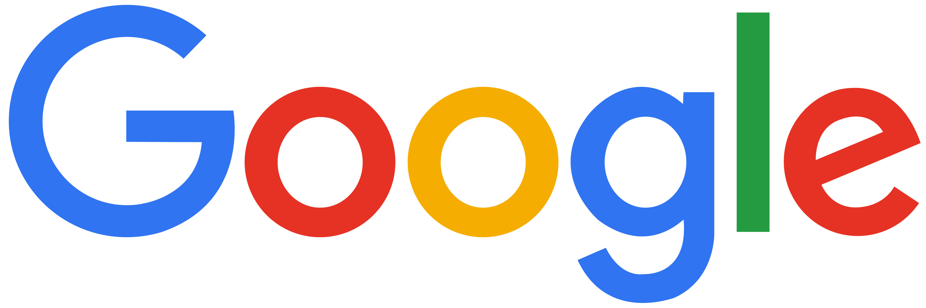
Python Commercial Usage
• Google
• Spotify
• Netflix
• Facebook
Google platform is mainly based on Python however it uses supporting Languages necessary
When created google main saying “Python where we can but C++ where me must"
Facebook use Python for scalability
Python is responsible for services such as TORconfig handling network switch and image setup
Netflix and Spotify use Python for data analytics to keep track of user’s input
Development pipeline is quick

Slide 6
Quiz
VEVOX
127-444-035

Slide 7
Thank you for listening, any questions?

Slide 8
Sources
Slide 1 Source (Guido van Rossum: Python and the Future of Programming | Lex Fridman Podcast #341 - YouTube)
Slide 3 sources (16 Examples of Global Companies Using Python in 2022 | Trio Developers
Top 10 Big Tier Companies That Use Python | HackerNoon
8 World-Class Software Companies That Use Python – Real Python)
Slide 4 16 Examples of Global Companies Using Python in 2022 | Trio Developers
Top 10 Big Tier Companies That Use Python | HackerNoon
8 World-Class Software Companies That Use Python – Real Python

